Slide 1
Visual pollution
Work of Tarek Abdulrahman Zain 1945973

Slide 2
Table of contents
01
02
03
The problem
Statistics
The solution
04
05
06
Solution
method
Results
Future work

Slide 3
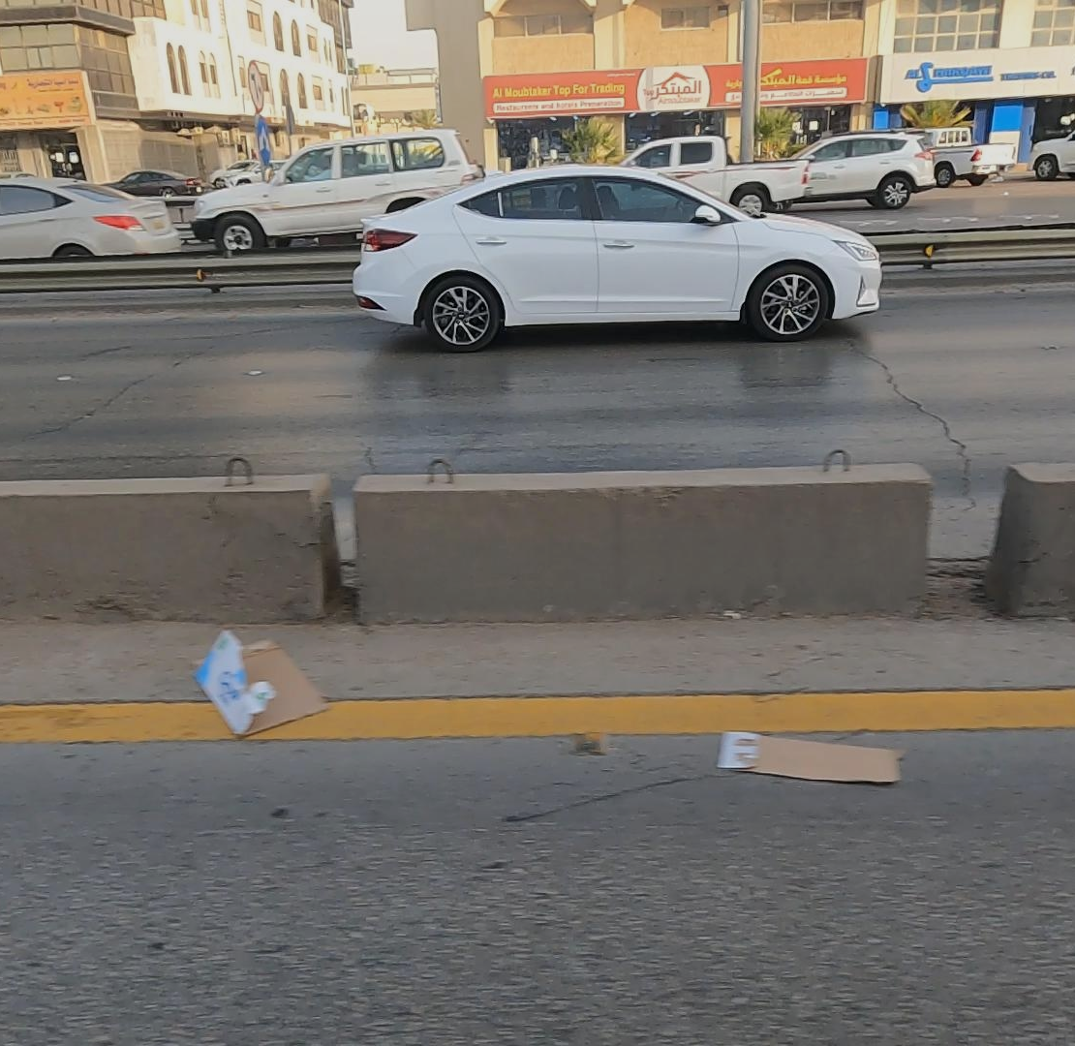
The problem
Visual pollution is considered as on one of the Modern day problems that has a deep impact on The aesthetics of the city and The well-being of Its residents

Slide 4

Statistics
1.7 million
4k worker
28k
Spectate in Saudi Arabia
Visual pollution Manual detections monthly

Slide 5
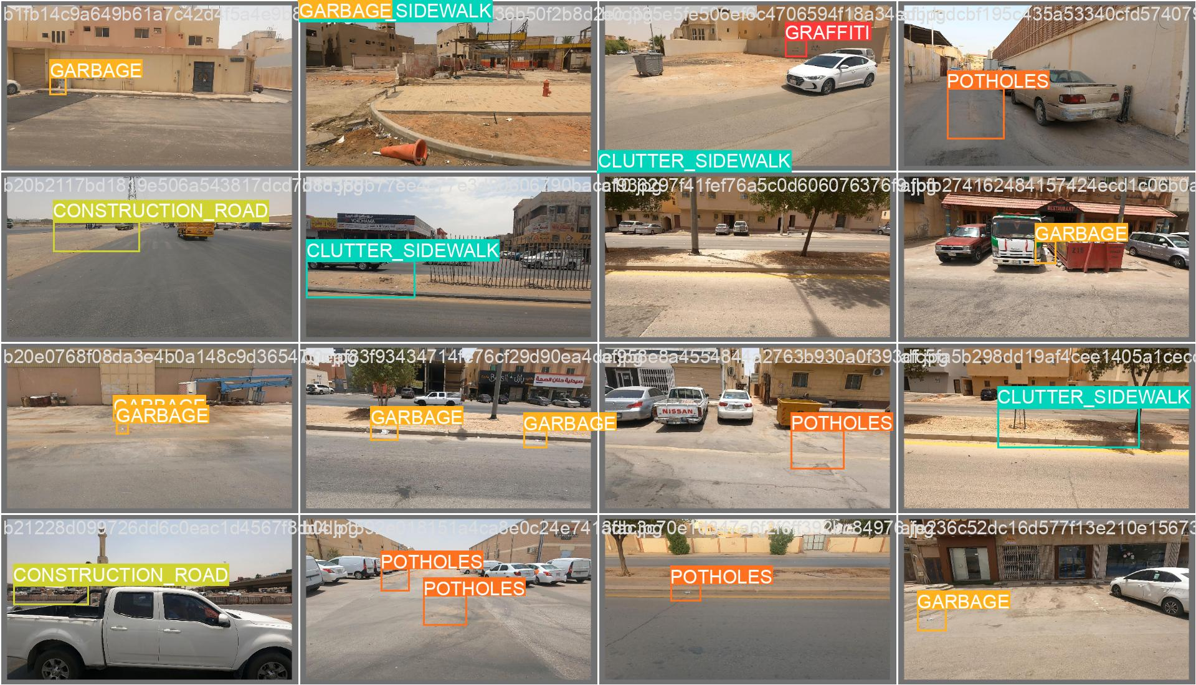
What is the Solution?
Developing a machine learning model using computer vision techniques to automatically detect visual pollution through cameras, and then providing the relevant authorities with the locations of the distortions.

Slide 6
ML model
Applied image preprocessing techniques, including resizing and normalization
Prepared the dataset for effective CNN model training, focusing on pollution features
The solution in depth
“ Technicalities ”
Training process
Evaluation Metrics
Data preprocessing
Chose CNN for its proficiency in image analysis and pattern recognition.
Ideal for identifying complex patterns of visual pollution
Incorporated YOLOv8 for enhanced object detection capabilities, thus Utilized more accurate, real-time pollution identification
Divided the dataset into training and validation sets
Employed cross-validation and optimization techniques for model refinement
Used accuracy, precision, and recall as well as confusion matrix to evaluate model effectiveness.

Slide 7
Results!

Slide 8

Model evaluation
Normalized confusion matrix
displaying the proportion of correct and incorrect predictions relative to the total predictions for each class

Slide 9
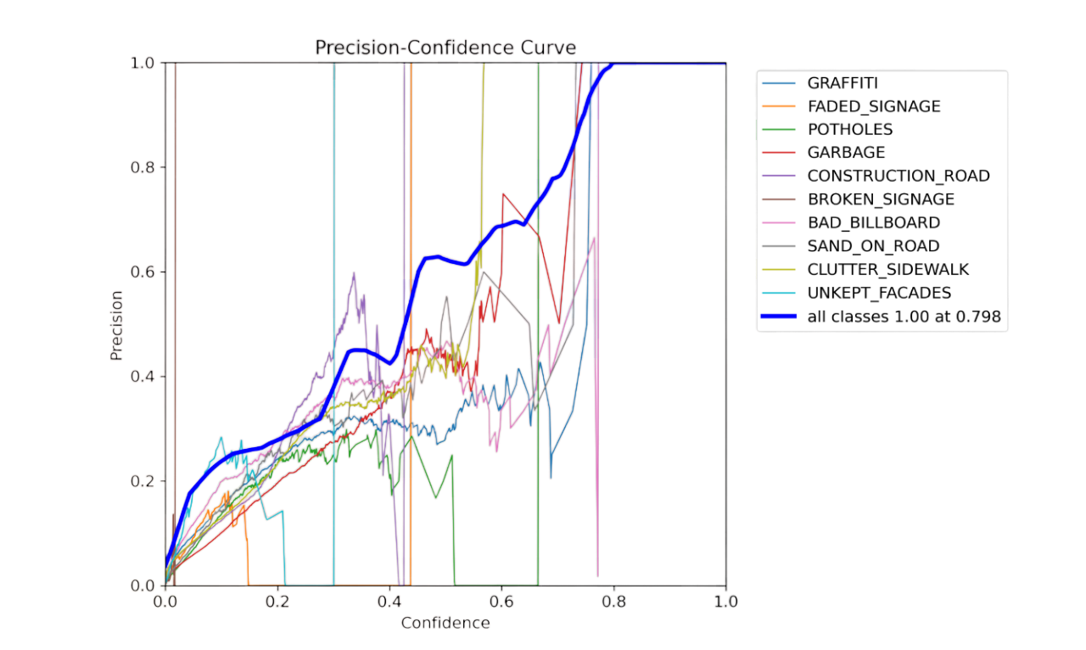
Model evaluation continued
Precision to Confidence
Measuring of the accuracy of the positive predictions made by a classification model

Slide 10
Challenges and difficulties
1
3
Many data preprocessing practices e.g. handling negatives and normalizing values between 0&1
YOlO without medium software (Roboflow). Poor documentation
Large number of instances, Bad dataset annotation
2
Creation of extra parameters
4

Slide 11
Explore Models
Collect more diverse samples to improve model generalization.
In addition, enhanced data Augmentation
Future work
Multinomial Techniques
Hyperparameter Optimization
Expand Dataset
Test various object detection architectures for optimal performance
Apply One vs. One strategy for better handling of class imbalance.
Fine-tune the model, e.g. increasing # of epochs for better learning outcomes.

Slide 12
Thanks!
Do you have any questions?
Tarek Zain

